Slide 1
Life Transitions: Easing Into Parenthood
Team: #7
Team Name: The Seven
Team Members: Mehroos Ali, Soumadeep Basu, Mary Grace Kozuch, Sudarshan Athreya Suresh

Slide 2
Goals - Main Areas of Focus

Slide 3
Simple: Choosing your hobbies and adding events / routines to your calendar based on interests.
GOAL: User wants to add/track their personal hobbies and goals.
Moderate: User can strike off or mark items/events on their schedule as done/completed as and when they finish. Once they do so, they get offered various incentives and rewards.
GOAL: User gets incentives to ensure that they stay on track to pursue hobbies/interests while still caring for their child
Complex: User can add a child and associated information about the child's schedule and habits. Once they do so, the app generates a custom schedule that ensure that pursuing goals does not mean neglecting the child in the users case.
GOAL: User needs to integrate their old life with their new schedule for the baby

Slide 4
UI Exploration

Slide 5
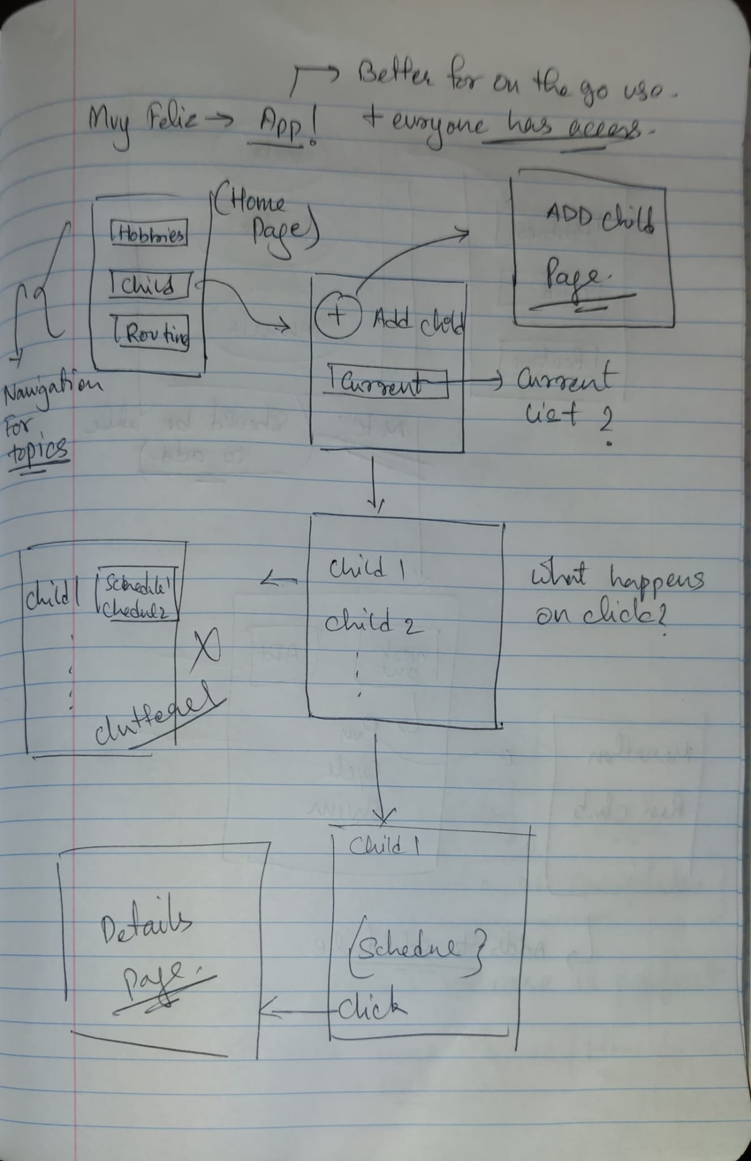
UI Exploration: Concept Sketch

Slide 6
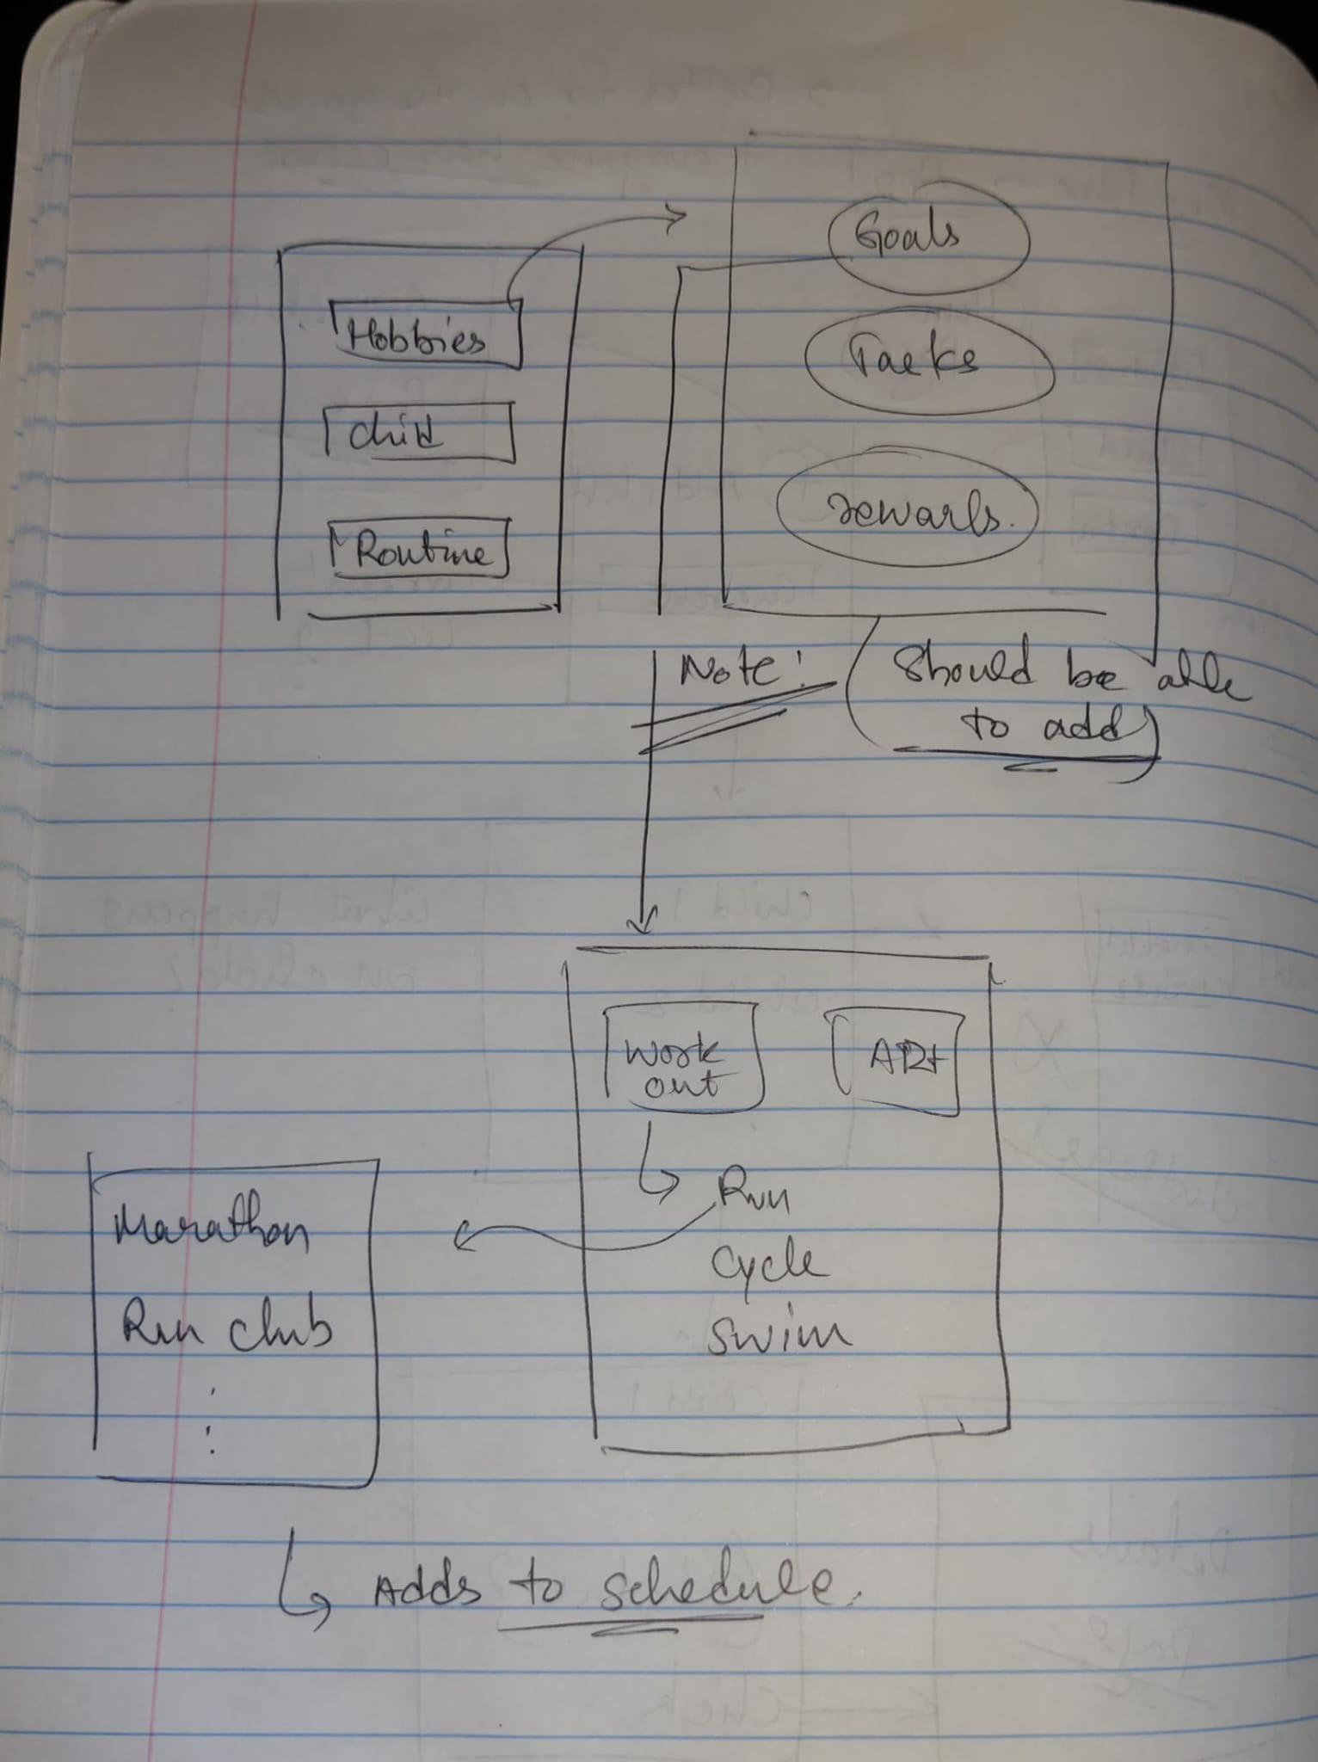

Slide 7
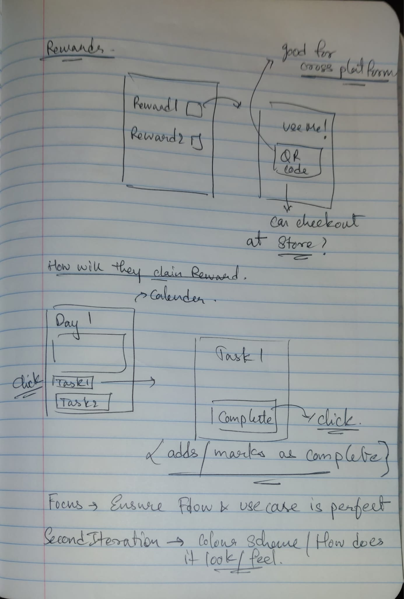

Slide 8
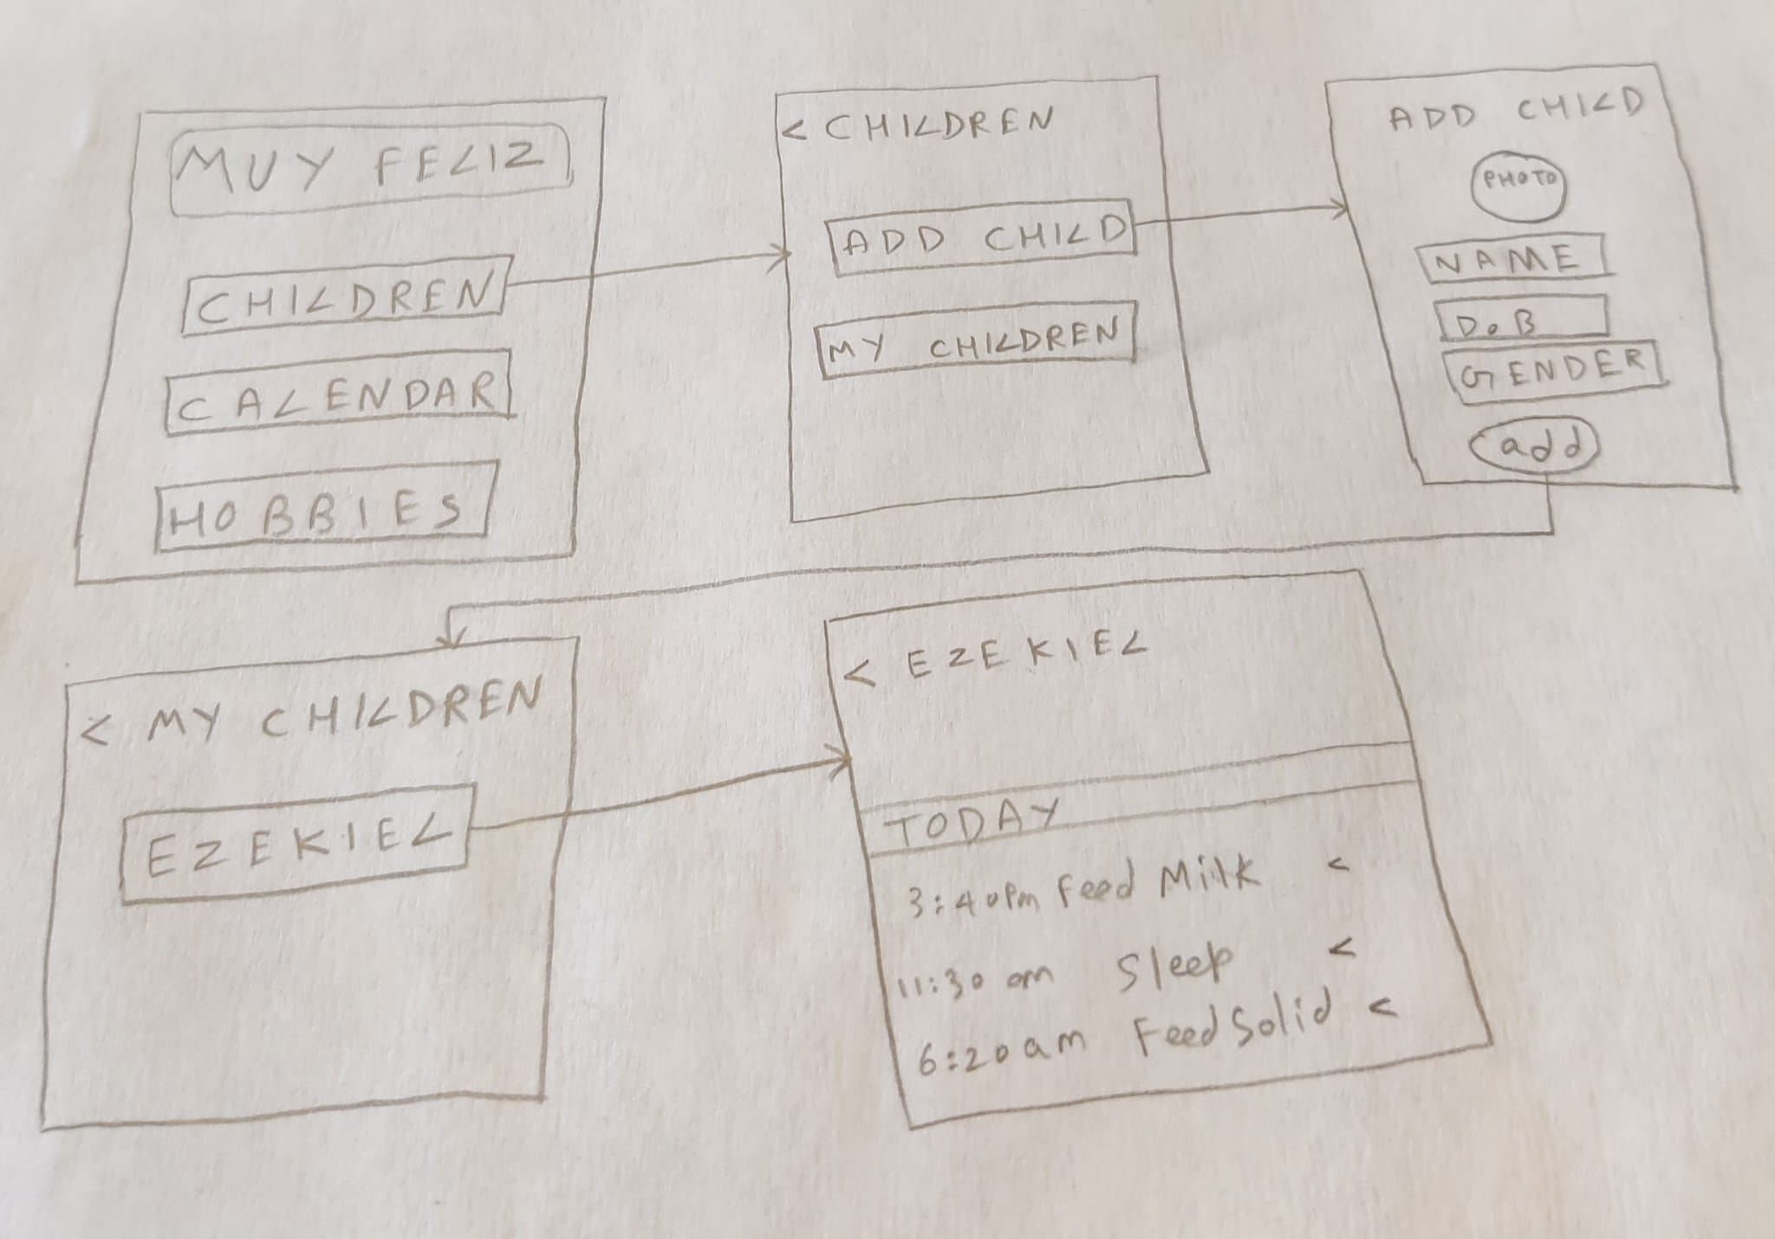
UI Task Flows
Adding Child and Associated Information

Slide 9
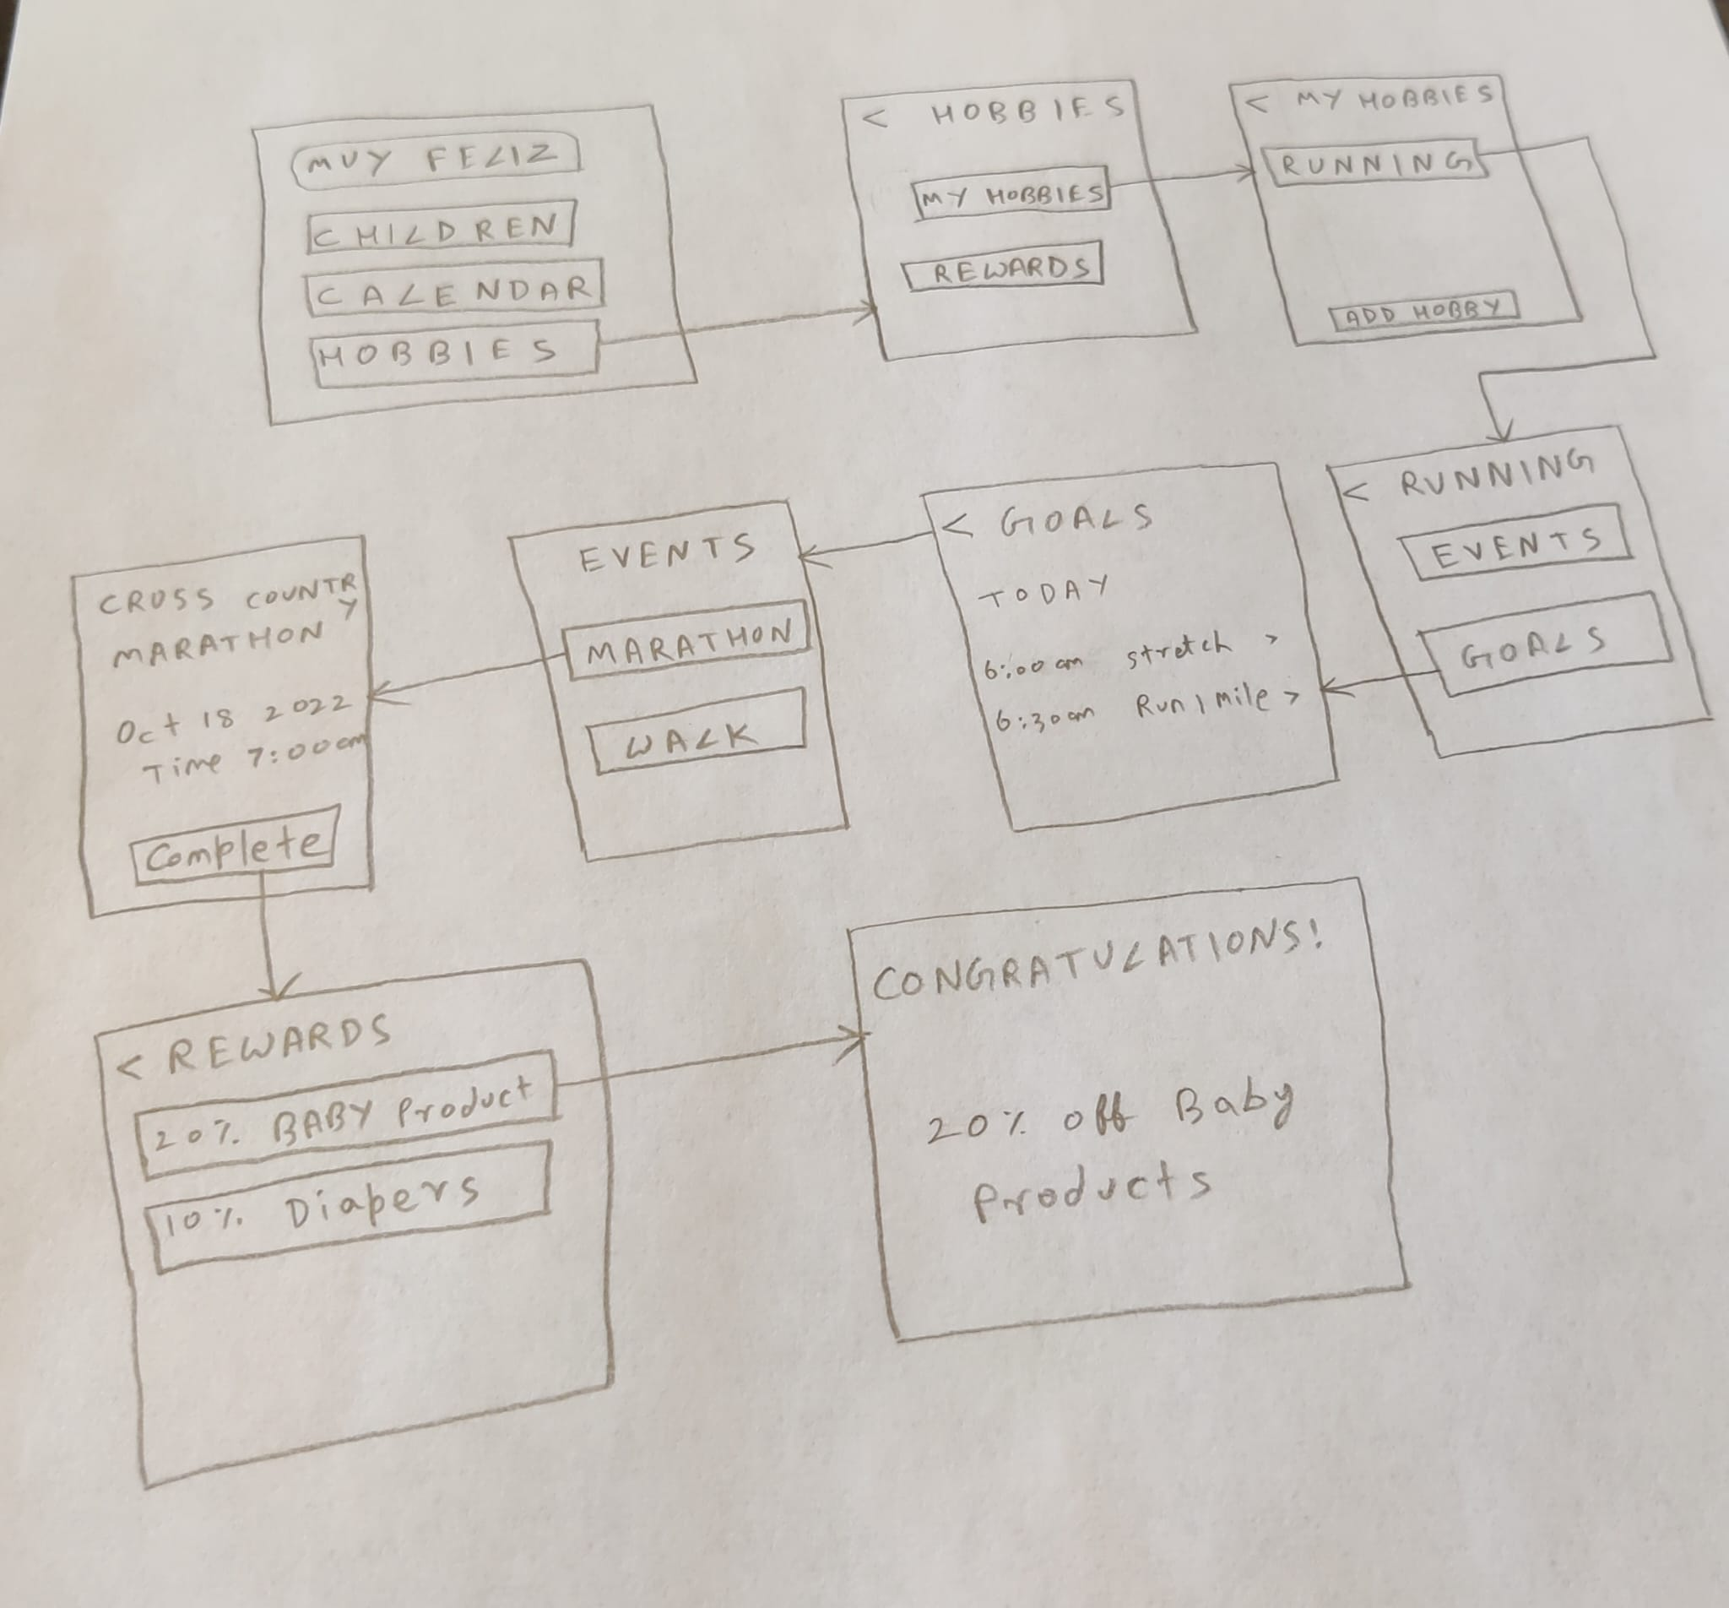
Marking Tasks as Complete and Claiming Rewards

Slide 10
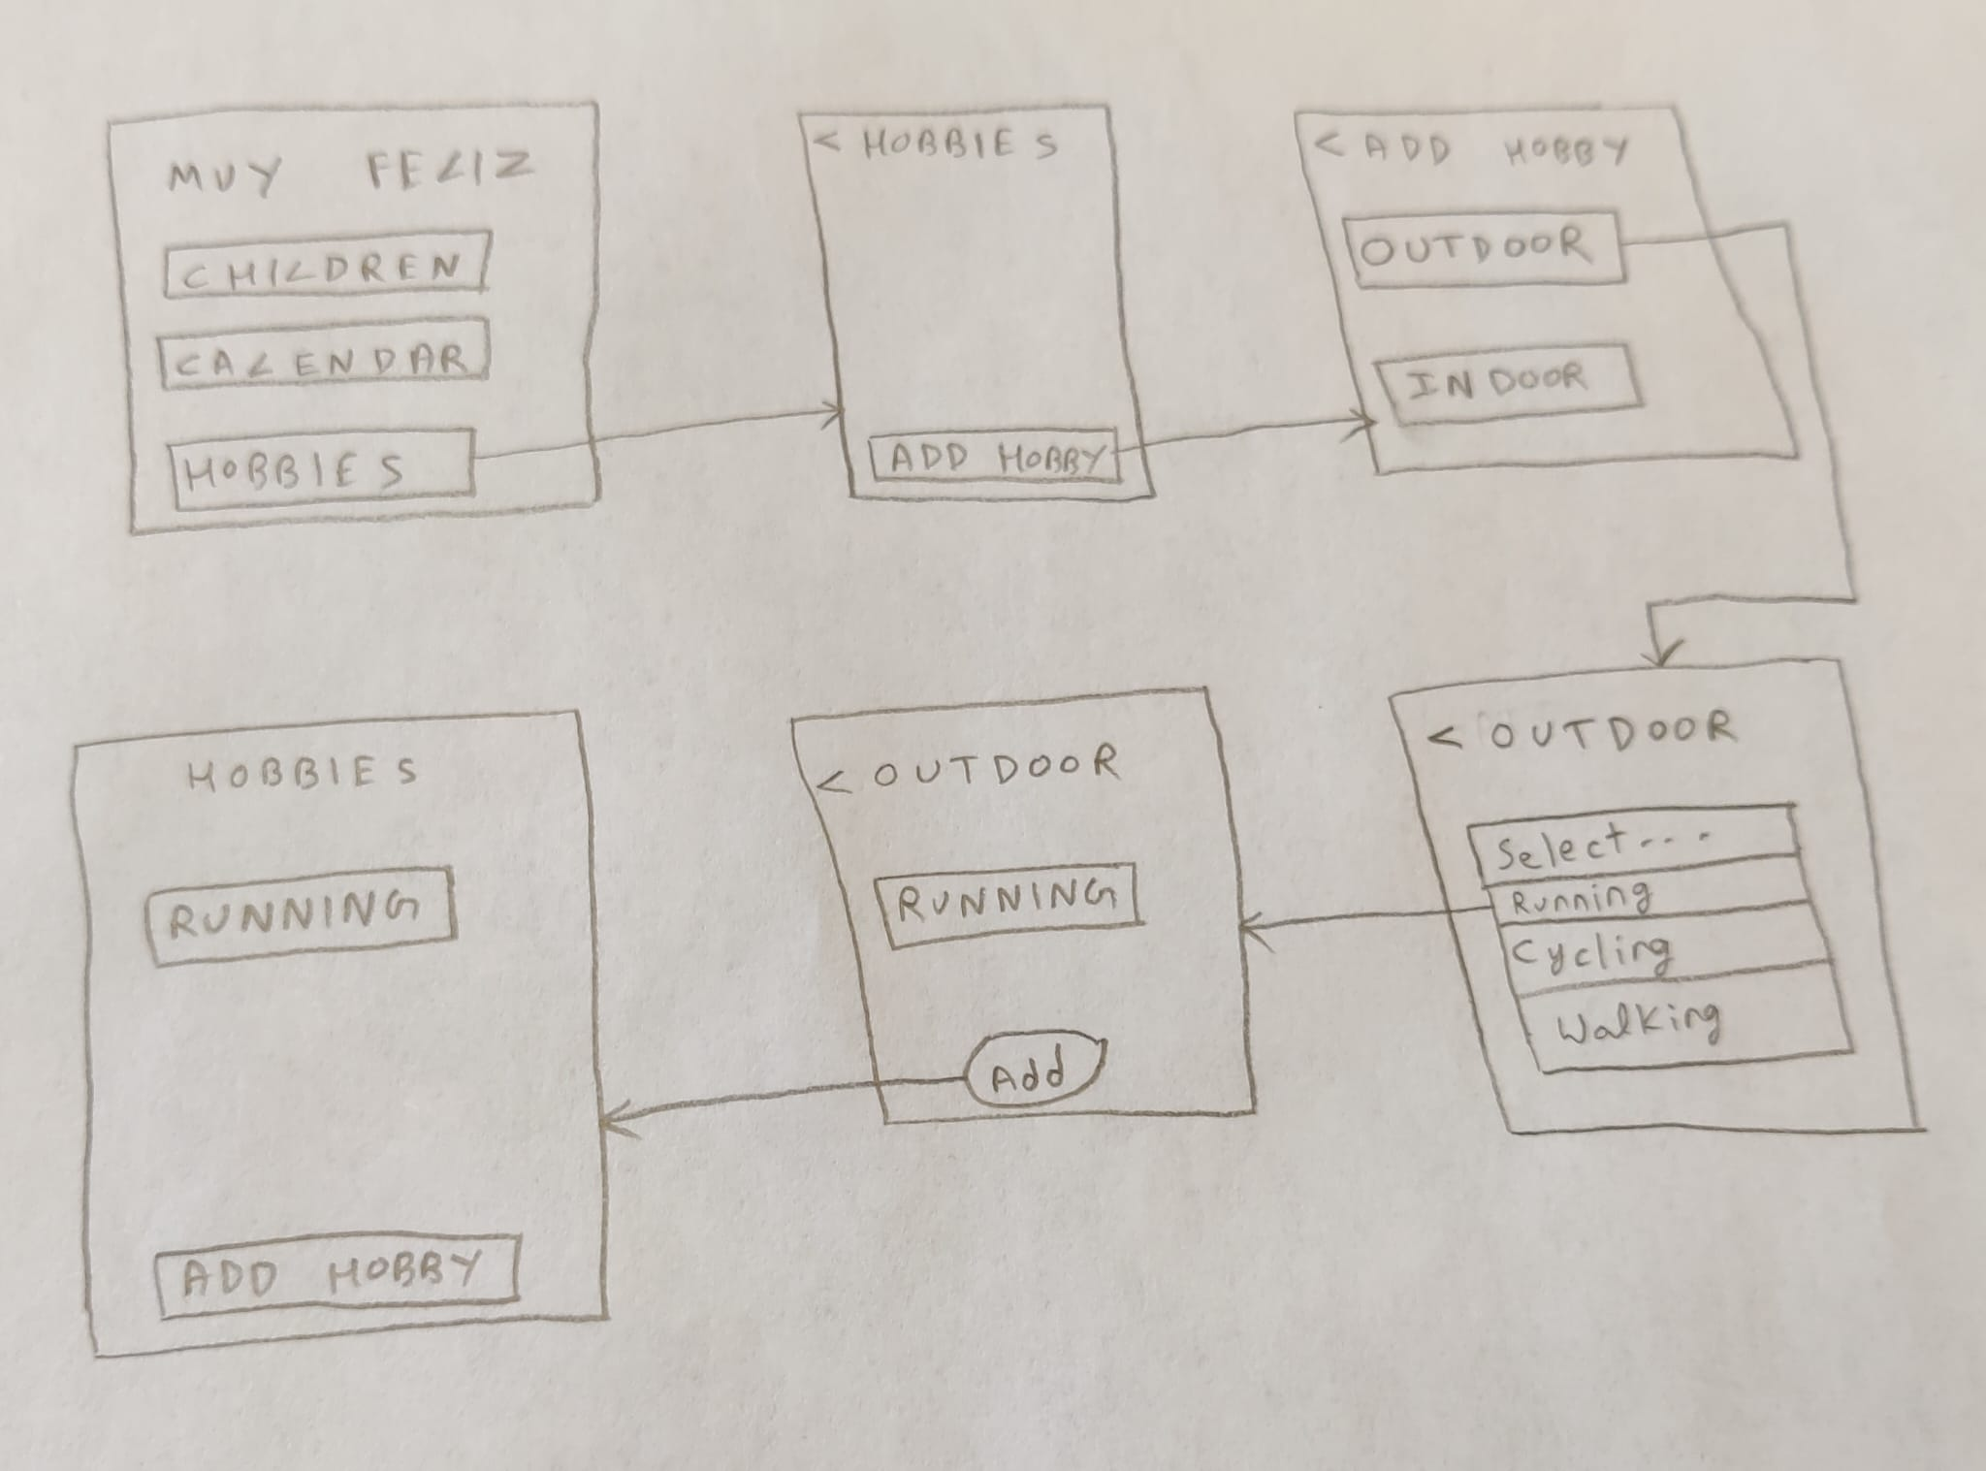
Adding New Events / Hobbies

Slide 11
Prototype

Slide 12
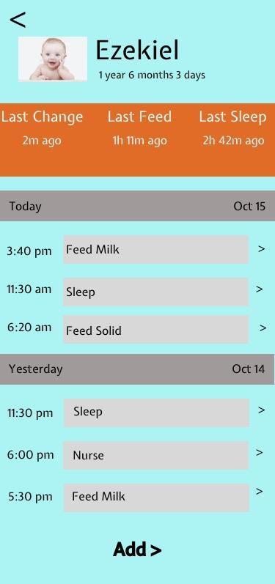
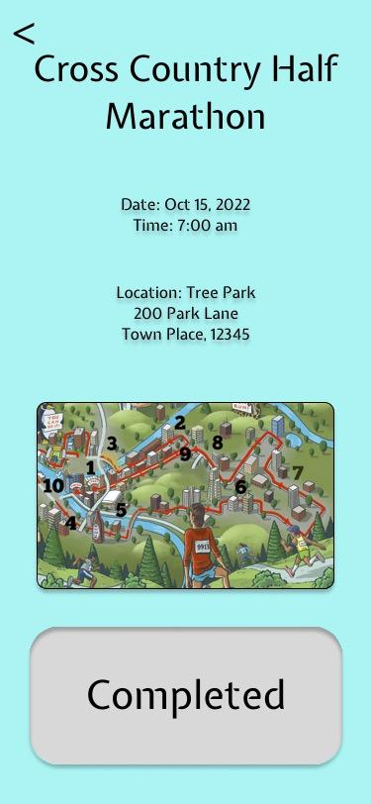
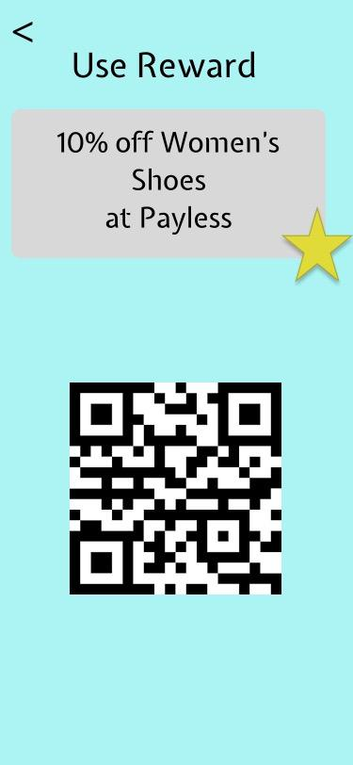
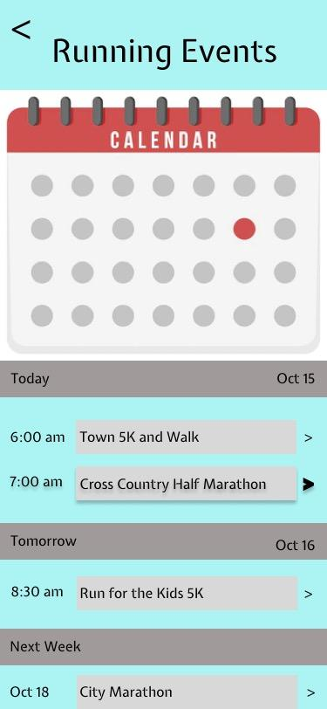
Prototype: Important Screens
Baby’s Schedule Adding Rewards Tracking Goals

Slide 13
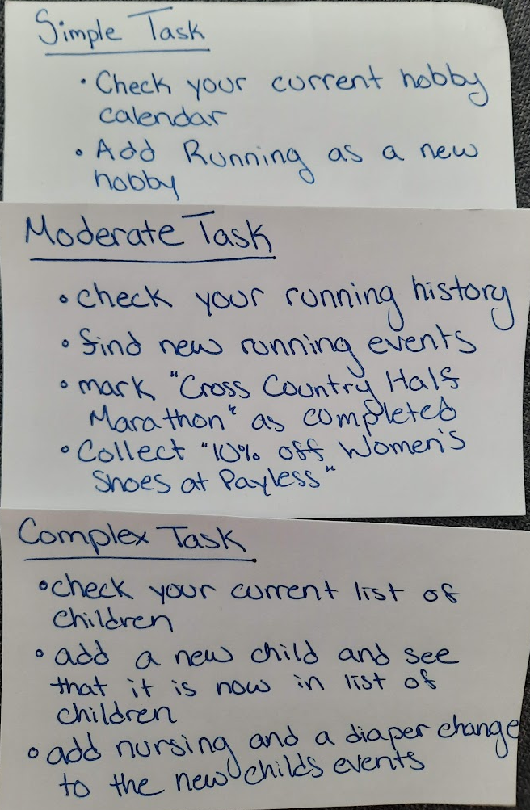
Info Card : Instructions given to Participants
As you have just seen , this app can do a lot ! But to make progress, we have to move forward !
You are one of the select few that have been chosen to help us make it better !
Here is how you can help.
Step 1 : You will be given a model app. Feel free to explore, it is dynamic !
Step 2 : Try your best to do the following : view your calendar, add a child, choose a new hobby and finally, claim a reward.
Notes:
Feedback is very valuable, notice something off or think it can be better ? Tell us !
Click buttons to navigate to pages, note that because this is a prototype not all buttons might be responsive. As long as you try to reach your goal however, you will be fine !

Slide 14
Prototype: Link
Prototype: Tools
https://marvelapp.com/prototype/82dif37/screen/89184702
Figma
It has real-time collaboration ! Helped us design pages together, even from a virtual setting.
Also has support for web, mobile and PC. As we are designing a mobile app, this helped setting the frame.
Figma offers a variety of customizable templates, widgets.
Beginner friendly UI designing.
Marvel
Allowed us to develop a reactive app and test the same fast.
Easy linking of pages and importing of design from figma.
Easy editing and collaboration across teammates.
Easy to share the link to the participant and to each other.

Slide 15
Participants

Slide 16
Participants
Participant 1:
Demographics: 23, Male
How & Why : Participant is a friend of one of the team members. He was asked to test the prototype based on his time availability. Because he is someone with no relation to the app or the target group, his feedback is unbiased and valuable
Location of user test: Participant’s home
Participant 2:
Demographics: 29, Male
Recruitment tactic: Participant is a software developer. Once again, he was asked to test the prototype based on his time availability. Because he is familiar with the app development processes, his technical expertise offers both a functional and creative outlook.
Location of user test: Participant’s home
Participant 3:
Demographics: 22, Female
Recruitment tactic: Participant is an arts major student here at UTD. Available for the interview based on request. Her unique artistic insight can better the design and user experience of the project.
Location of user test: Java Land Coffee House

Slide 17
User Test

Slide 18
User Test: Videos
Participant 1- https://youtu.be/_lyg5Dh3Nwk
Participant 2 - https://youtu.be/We5YmJseLRU
Participant 3 - https://youtu.be/0y03bGM62PA
Extra Participant - https://youtu.be/zidT1cIxFSg
(We had an extra volunteer ! Although not referenced directly, this persons feedback was incorporated in the user feedback slides !! )

Slide 19
User Test: Briefing
Muy Feliz is an application which allows parents to input a glimpse of their life before parenthood through hobbies, passions and so much more. Examples of such include baking, running, cycling etc.
As part of the process you need to enter your babies schedule as well choices for what you wish to currently pursue (eg : running).
The application will then create a schedule keeping the baby in mind, which allows the parent to accomplish as many of their goals as they would like ! Further, this is flexible with the child’s schedule throughout the day and updates to this schedule can be made as and when required.
Lastly, the application will also give incentives to motivate users to stay on track with personal goals they have chosen to pursue !

Slide 20
User Test: Notes
Participants took a while to decide which button to click, app should have better visual hierarchy.
Difference between calendar on the home screen and on the hobbies screen was confusing
Button Names should be more distinct and design should be a bit more intuitive.
App seems to be lifeless, does not seem to invoke smiles like the concept video did.
There seems to be no trademark feature of the app. All components seem cookie cutter. This is ofcourse a result of using a design tool with inbuilt icons, but it definitely is something to keep in mind going forward as we design the UI further.

Slide 21
User Test: Roles
Overview : For user testing, as a group we worked with the schedules of the different participants and then scheduled interviews. Briefing, recording, and note taking were done on a rotational basis.
We can see the rotations below.
Mehroos Ali - Recorded for participant 2, Took notes for Participant 1, Briefed Participant 1
Soumadeep Basu - Recorded for Participant 3, Briefed Participant 2, Took Notes for Participant 2
Mary Grace Kozuch - Took Notes for Participant 3, Recorded Participant 1
Sudarshan Athreya Suresh - Briefed Participant 3, Notes for Participant 1,2
Lastly, as a team we also decided on the briefing content and the user cards. Editing the videos and uploading to YT were done through Mehroos’s youtube channel !

Slide 22
User Test Analysis

Slide 23
User Test Analysis: Problems
Usability Problem | Level | Participant
Too many buttons, over crowded design. Reduce complexity and reuse components. | High | P2,P3
Too many Icons in the Baby’s Schedule. Make it easier to Read/Navigate | High | P1,P2,P3
Having Two Calendars, seems confusing. One on the home screen and one in the Hobby screen. Incorporating all into one would be nicer. | High | P1,P2
No component of the design invokes parenthood apart from the baby pictures | High | P1,P3
Since all the backgrounds and pages look the same, there is no context clues / visual distinctions of function | Medium | P2
Color Scheme does not match the app’s goal. Colors are not complementing as well. | Medium | P3
Only way to change the date / day should not be by pressing calendar. More intuitive design is needed | Medium | P1,P3
Swipes/Clicks are not the best way to transition. (referencing last page, baby calendar) | Low | P1,P2,P3
QR code might not be accepted in some places as a valid way to avail discount / reward | Low | P2,P3
Make buttons and components uniform. Design should be consistent | Low | P3

Slide 24
User Test Analysis: Feedback
Although the functionality seemed to be satisfactory, user testing revealed some critical areas of improvement.
Primarily in terms of design we have to ensure that our look, colour, and feel invokes parenthood. Further, the design should not be cookie cutter while we start designing the UI.
Design of the UI should not be cluttered. Lots of components are extra, verbose and cumbersome. Make solutions elegant and sleek.
Clicks and swipes should not be the only way to navigate. Even if they are the action, there should be cues and visual hierarchies to guide the intuition of the user.
Colours, buttons and other components should be uniform.
Pages should be contextualized based on use case.

